Slide 1
Unit 70 Computer Game Engines
Game Title: Boy
Assignment 2
Design and Developing a Video Game by using 2D Game Engine
Name: Joseph Roper

Slide 2
Task Introduction;
My name is Joseph Roper and I am doing the task to introduce the video game I have created by using a 2D game engine called Construct 2 .
The video game I’m going to be talking about is called Boy.
My game is about a young child trying to find his parents in a shanty town while escaping the police by solving puzzles and platforming.
The highlights of my game will be the story and the emotional connection being created by player and the boy.

Slide 3
The Story
The player a young child tries to steal bread from a shop keep in a shanty town and ends up getting caught, the punishment is death he has to escape and run away everyone is trying to chase him so he has to jump onto unsafe roofs and run for his life until he gets to the big city. Safety. He has to do all of this while still maintaining his health by getting food and drink, washing and well not dying from sharp objects. The boy’s objective is to make it to the big city where he has heard dreams come true and people don’t starve there. At the end of the game when the boy makes it to the big city he ends up getting finally caught by the guard who first threw him in jail he takes him to the local police station to meet his parents which the guard was trying to do in the first place. The guards and everyone calls the child boy but when he meets his parents at the end of the game he finds out his name is Mvulana which is Swahili for boy so the whole game everyone was just calling out his name to get him home safe to his parents.

Slide 4
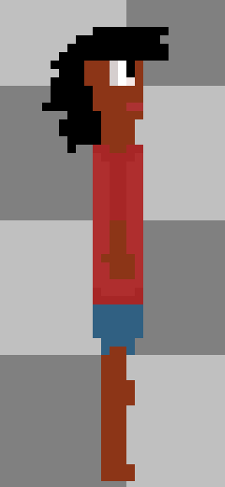
Characters – Types and Backstory
Mvulana
Character Picture
Character’s Name: Mvulana
Character Type: Protagonist (Playable Character)
Character Backstory: He is 12 years old and has parents, he used to have a little sister who was stoned to death for committing a crime no one knows. Mvulana has been haunted by his sister’s death and because of this he trusts no one apart from his parents.
Capabilities: Mvulana is quick, nimble and also small meaning he can fit through small holes and cracks.

Slide 5
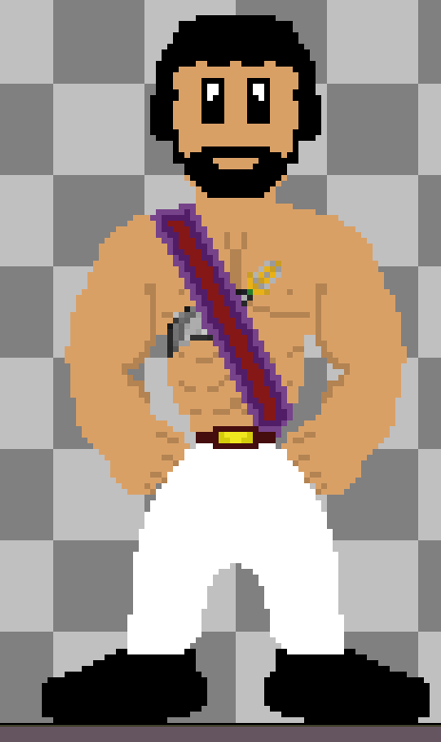
Characters – Types and Backstory
Head Guard
Character Picture
Character’s Name: Head Guard
Character Type: Antagonist (NPC – Non Playable Character)
Character Backstory: He is the head guard of the police force from the big city and is currently working in the slums to stop violence that is why he stopped the shop keeper from attacking Mvulana. He also is old friends with Mvulana’s parents and that is why he took Mvulana to the station to reunite him with his parents.
Capabilities: Is big and strong and has a sword on him.

Slide 6
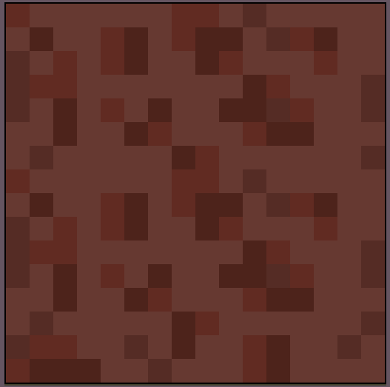
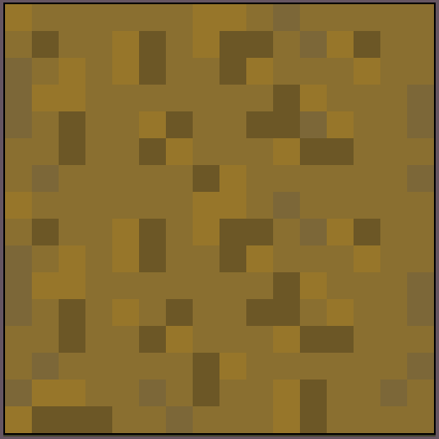
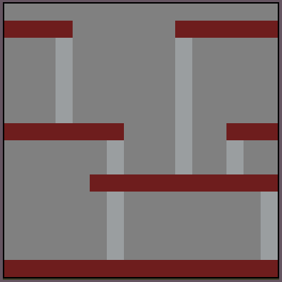
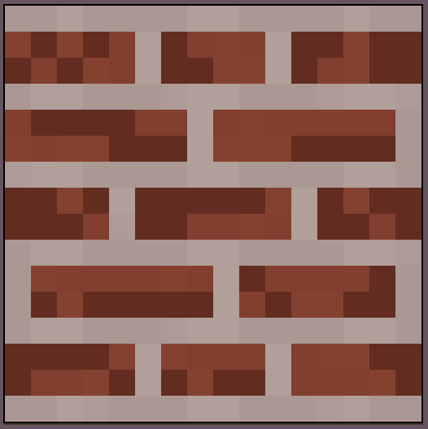
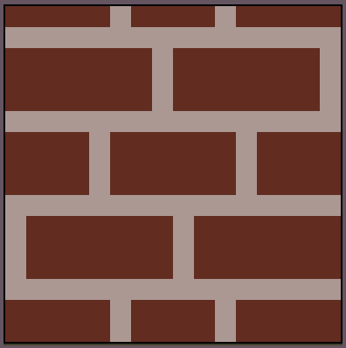
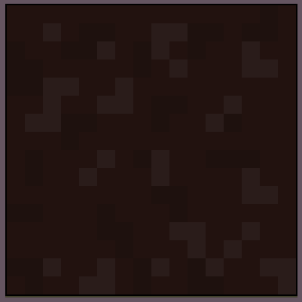
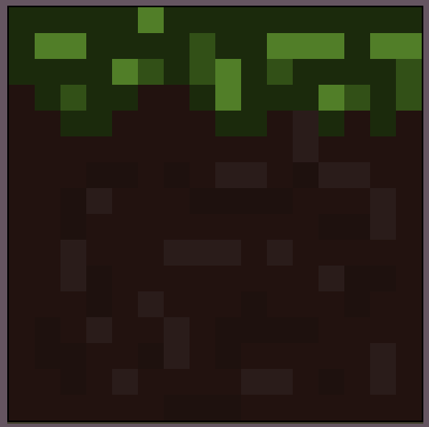
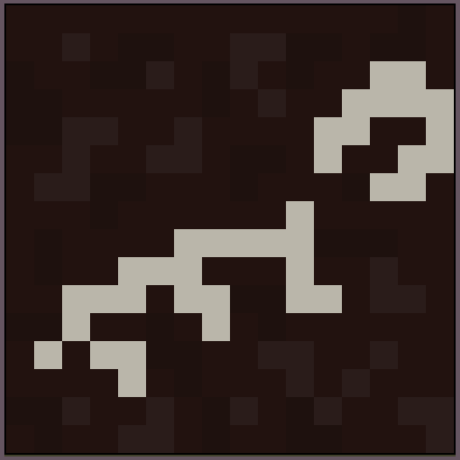
Computer Game Terrain
The terrain of my game will have sand, scaffolding and course dirt. To represent what it is like in a shanty town.

Slide 7
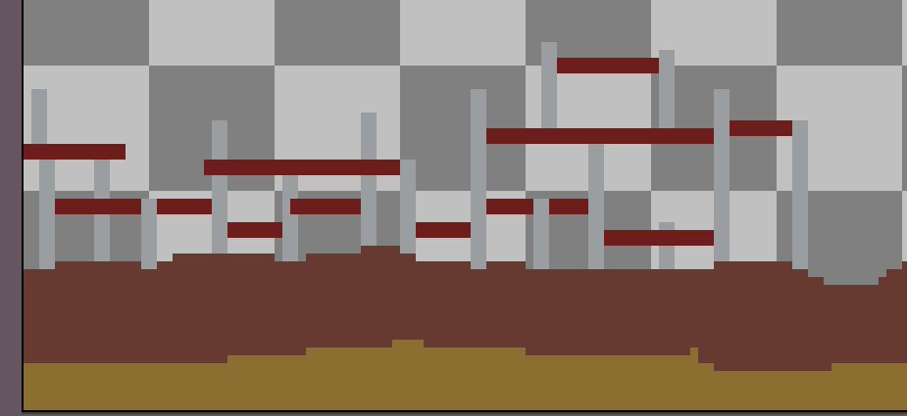
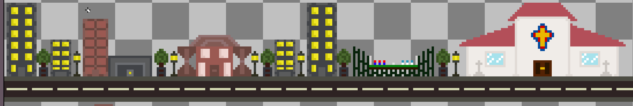
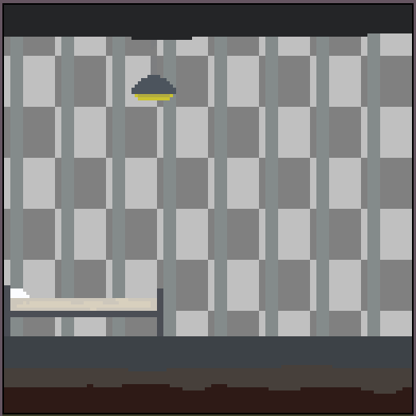
Computer Game Architecture
My games architecture for the shanty town will be filled with scaffolding and half mad houses.
The architecture for the big city what the player will go to at the end of the game will have an everlasting rode filled with shops and leisurely activity buildings.
There will also a point in the game where the player will be trapped in a jail cell.

Slide 8
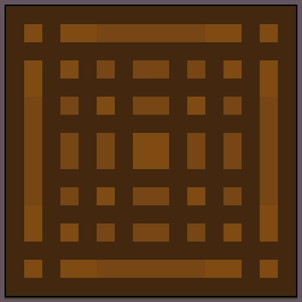
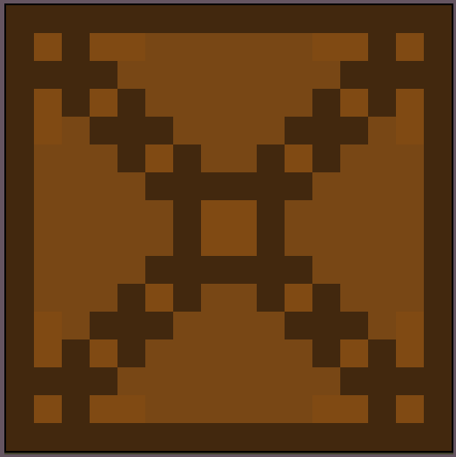

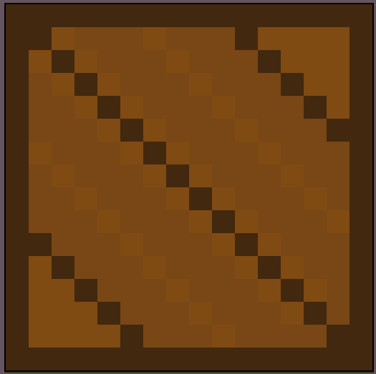
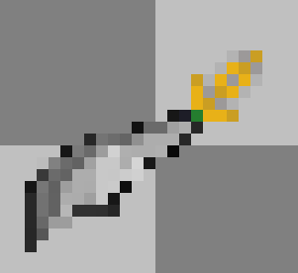
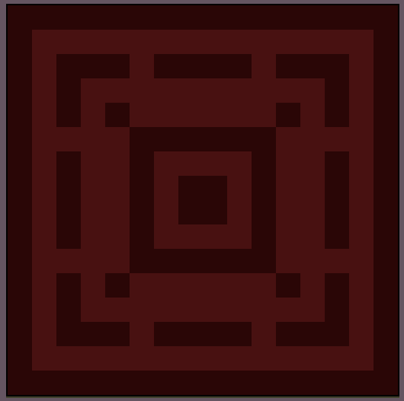
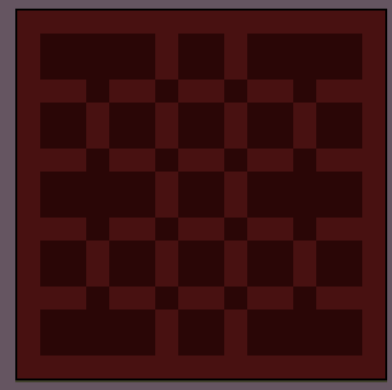
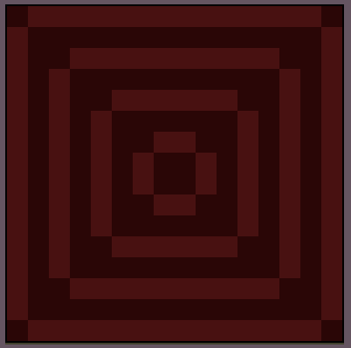
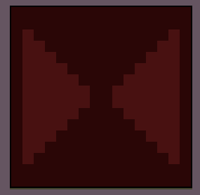

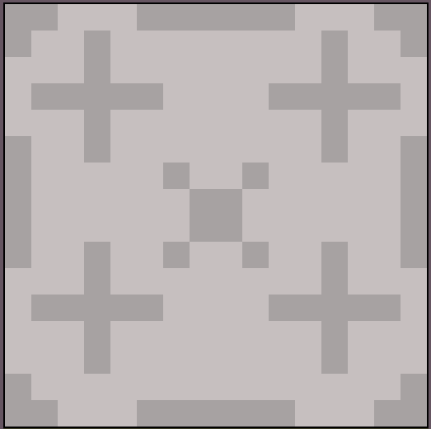
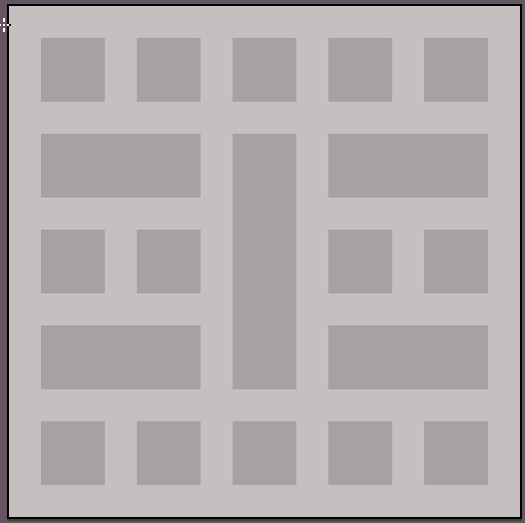
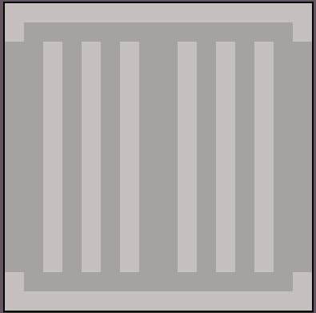
Computer Game Objects
In my game there will be boxes and various over objects for the character to hide behind.
This is the head guards weapon

Slide 9
Computer Game Assets Feedback
I have made an asset review which is a PowerPoint presentation with all my game assets on it reviewed by two of my fellow classmates. It will be included with this presentation when uploaded.

Slide 10
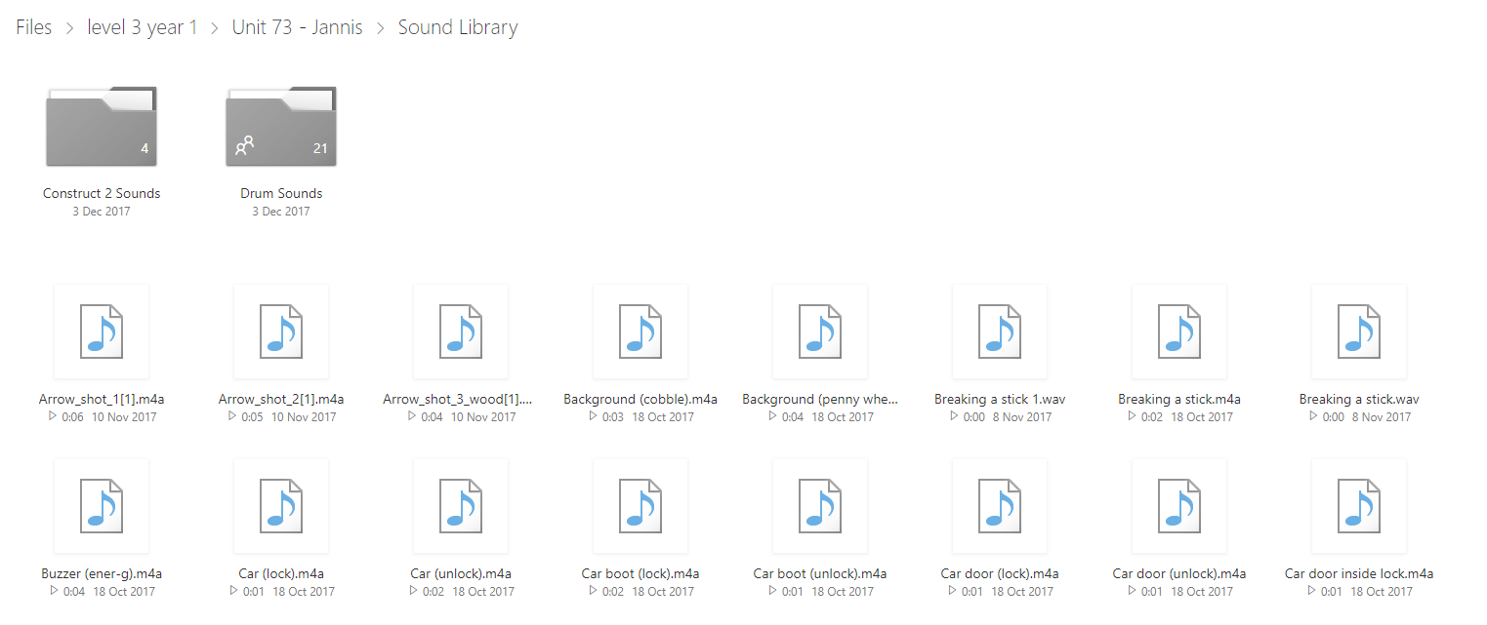
Computer Game Feedback
There are multiple ways of receiving feedback in my game. Firstly you have audio feedback as when the player is killed a death sound will play informing to the player that you have died. I have a sound library containing a bunch of sounds to be used in video games.

Slide 11
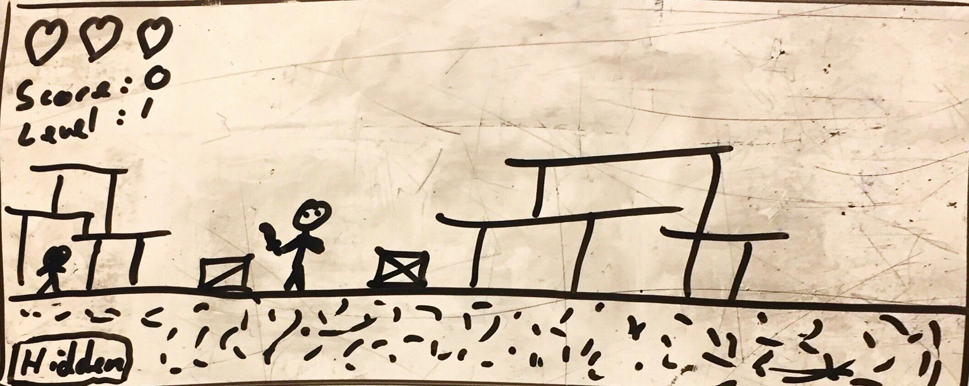
Computer Game Interface

Slide 12
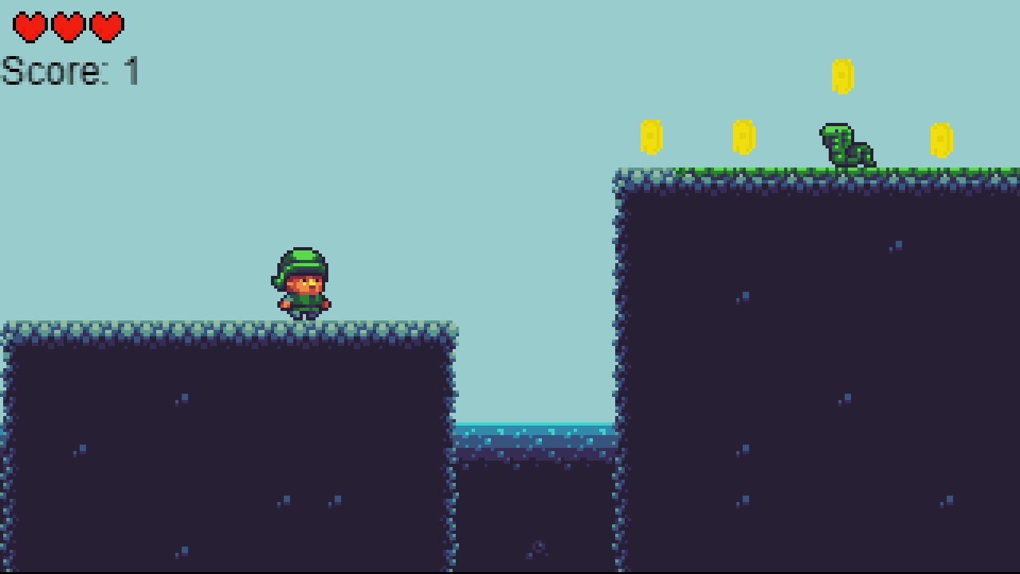
Computer Game Perspectives
My game will be 2D in a side-scroller perspective.

Slide 13
Computer Game FMV
There will be a full motion video cut scene at the start of the game and will show how the boy lost his parents. Then there will be another at the end of the game when the boy is reunited with his parents.

Slide 14
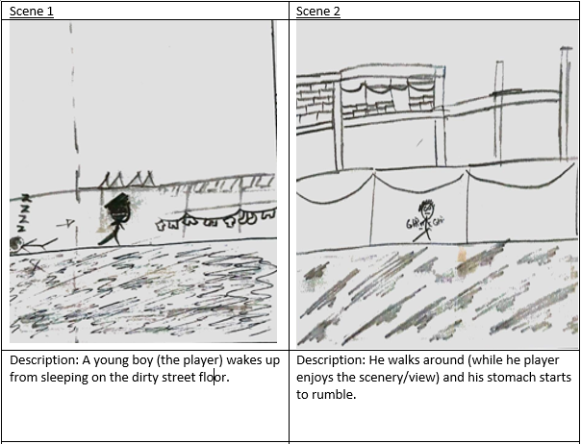
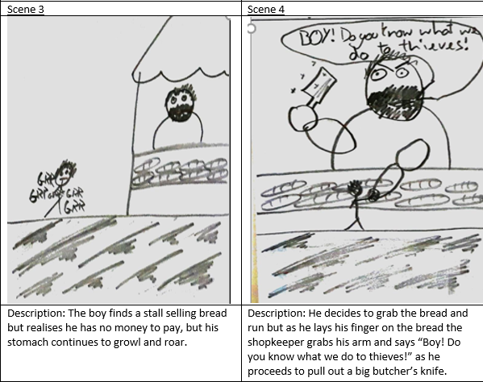
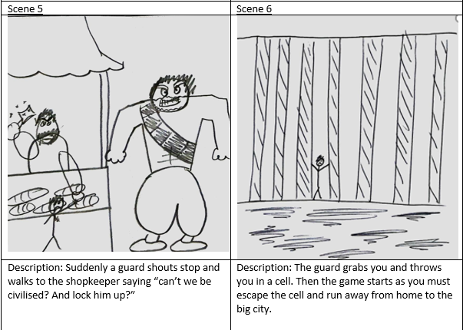
Storyboarding

Slide 15
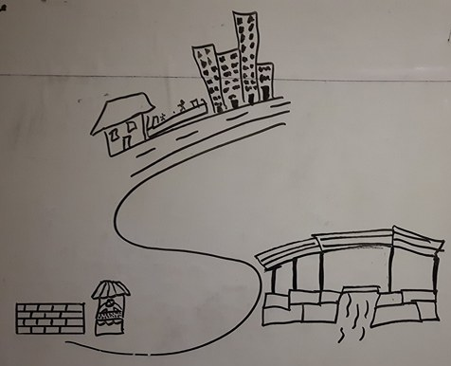
Map
This is my map for my Construct 2 game. The bottom left contains the starting area of the game. The bottom right contains the middle of the map where the player will be traversing through the depths of the shanty town by using parkour. The final section of the map is the Big City at the top where the player will be reunited with his parents. The map still needs to be polished and more things will be added later.

Slide 16
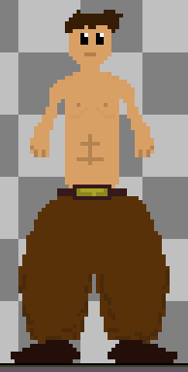
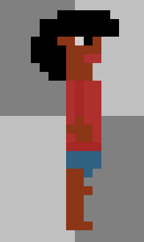
Sprites

Slide 17
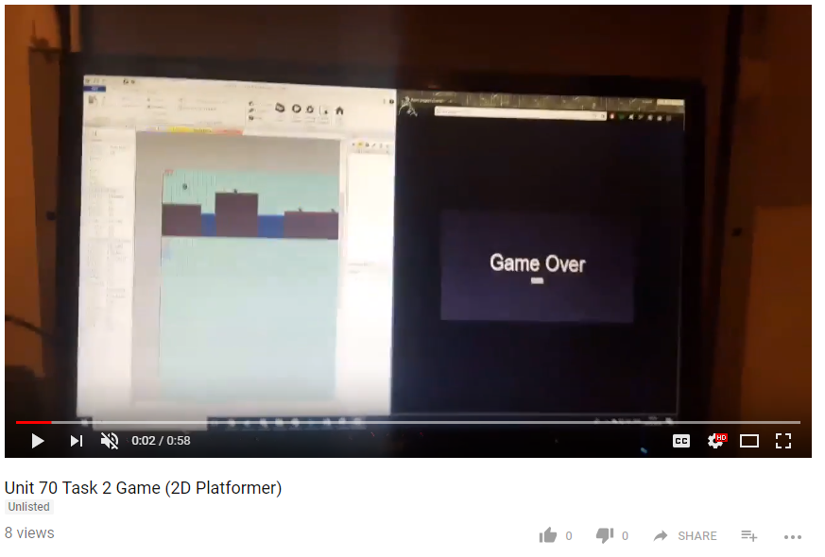
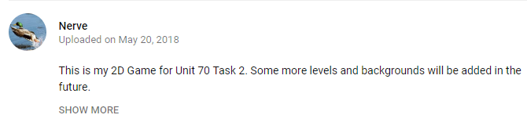
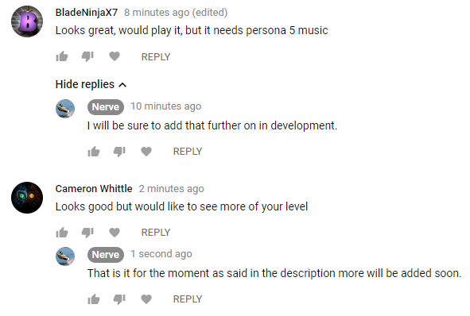
YouTube Video
https://www.youtube.com/watch?v=NVrUOH_y_cw&feature=youtu.be

Slide 18
Conclusion
I feel that my game turned out well even though I had to restart it multiple times due to the game engine I was using Unity which kept updating so my projects kept being deleted.
I have a few bugs that I need to fix as the sound effects are not playing and the players score turns blank after 9 points.

